Slide 1
State of the PD July 10, 2019

Slide 2
Demographics and Calls for Service
In 2018, the City of Fife had a population of 10,100 residents
That year, Fife Police Officers responded to 21,475 calls for service

Slide 3
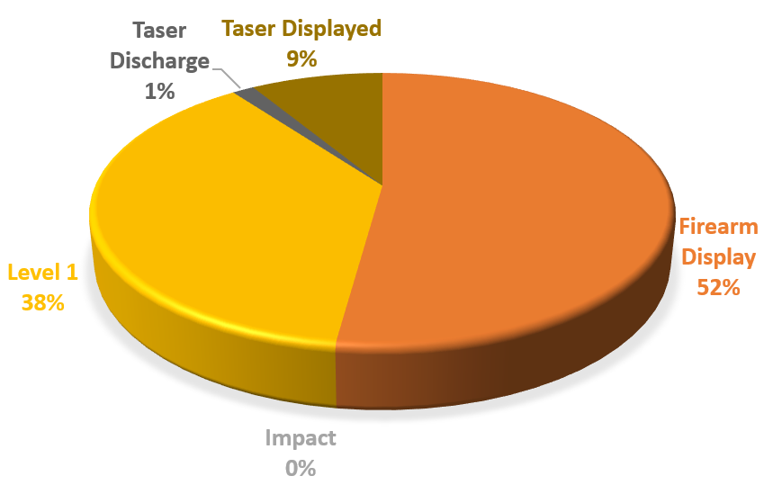
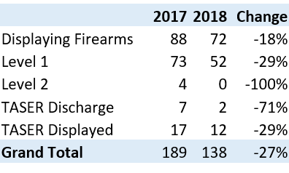
Use of Force
2018 Use of Force by Type
In 2018, Fife PD saw a significant reduction in use of force
2017 VS. 2018

Slide 4
Vehicle Pursuits
2017 vs. 2018
Pursuits have increased over the past few years. In 2018 we noticed a significant increase in more violent crimes that resulted in a pursuit.
2018 Vehicle Pursuits
In 2019, we implemented an even more stringent pursuit policy, limiting pursuits to dangerous felony crimes.

Slide 5
Crime Stats
Group A Offenses
In 2018, Pierce County experienced a -4.9% overall change in reported Group A offenses. During that same time period, Fife experienced a reduction of -9.1% overall.
Group A Arrest Overview
Arrest Total: 497
Adult Arrest Total: 482
Juvenile Arrest Total: 15
*Source: WASPC 2018 Washington NIBRS Submissions

Slide 6
Crime Stats
Group A Offenses
*Source: WASPC 2018 Washington NIBRS Submissions

Slide 7
Crime Stats
Calls for service
*Source: WASPC 2018 Washington NIBRS Submissions

Slide 8
Crime Stats
Group B Arrests
Drug Offenses by Type
2018 Property Values by Type
Relationship of Victim to Offender
*Source: WASPC 2018 Washington NIBRS Submissions

Slide 9
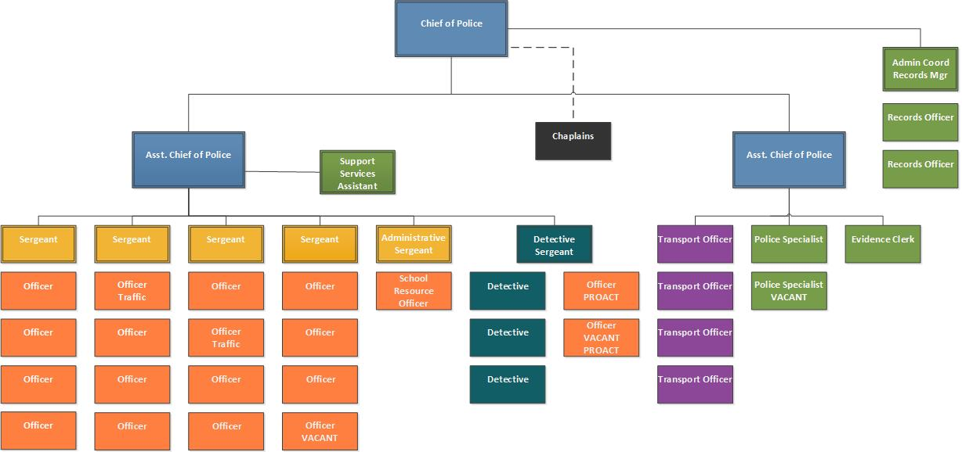
Organizational Structure
Eliminated Captain position to add an additional Officer to the road
Instituted Officer-In-Charge (OIC) Program
Enacted a schedule allowing for 24-hour supervisory coverage
Reclassified existing Sergeant into Administrative Sergeant
Added 4th Transport Officer and expanded duties of position to include Court Security
Eliminated Investigations Assistant role and created Support Services Assistant position

Slide 10
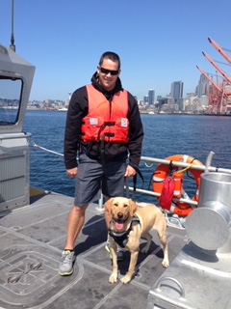
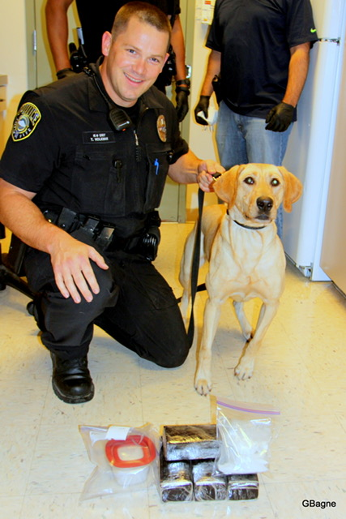
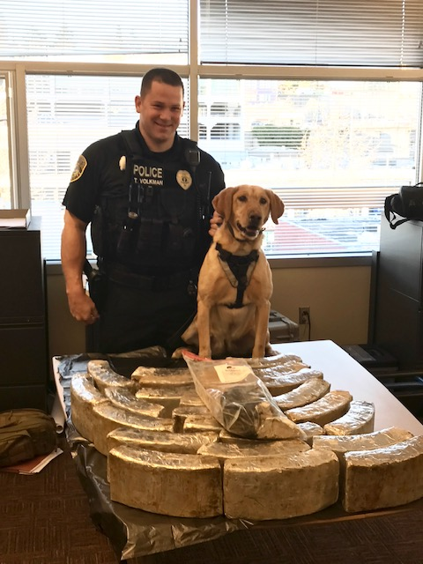
K9 Mia and Ofc. Volkman
2018 Stats:
Deployments: 21
Agency Assists: 13 (Including Coast Guard)
Guns Seized: 2
Money Seized: $2482
Cocaine Seized: 1,386.10 grams
Methamphetamine Seized: 193.10 grams
Heroin Seized: 507.9 grams
December 2018 marked the retirement of K9 Mia. There is currently a K9 opening.
Career Stats November 2013 to December 2018:
Deployments: Hundreds
Agency Assists: Over 100
Vehicles Seized by Fife PD: 19
US Currency Seized by Fife PD: $51,127
Total US Currency Seized: $598,301
Cocaine Seized: 6.3 lbs
Methamphetamine Seized: 194.5 lbs
Heroin Seized: 7 lbs
Street Value of Drugs Seized: $1.1 Million

Slide 11
Accreditation
Originally awarded in May of 2016, Fife PD is scheduled for Re-Accreditation in 2020
What is Accreditation?
Overseen by the Washington State Association of Sheriffs and Police Chiefs Professional Services Committee, Accreditation Commission, and Board of Directors, the accreditation program provides a review process for agencies to be certified as operating under industry best practices and standards.
What are the benefits of Accreditation?
To increase public confidence in the agency
To increase credibility
To provide systemized agency self-assessment
To broaden perspectives
To intensify administrative and operational effectiveness
To ensure recruitment, selection, and promotion processes are fair and equitable
To strengthen understanding of agency policies and procedures by agency personnel
To improve agency morale and pride
To decrease susceptibility to litigation and costly civil court settlements;
To potentially reduce liability insurance costs
To provide state and local recognition of professional competence.
*Courtesy www.waspc.org/accreditation

Slide 12
Accreditation
Accreditation is comprised of 137 standards that are “have-to practices” as determined by law or a universal practice within the profession and are mandatory for every agency.
Within the 137 standards are 8 standards that require annual proofs in each file:
The agency has a strategic plan or written goals and objectives that are reviewed and updated at least annually and are available to all personnel.
The agency has a policy that requires an annual management review and analysis, with final review approved by the chief executive officer, of the following incidents:
Vehicle Pursuits; Use of Force events; Internal Investigations; Biased Based Profiling Incidents
The agency has a system to document and record the use of cash funds that include receipts, supervisory approval, and periodic audit.
The agency can show 100% compliance with the annual WSCJTC requirement for training.
At least annually, agency personnel receive in-service training on the agency’s use of force and deadly force policies.
The agency has an evaluation policy that requires formal written review of the work performance of each employee and is conducted annually.
The agency ensures that an unannounced audit of evidence and property, including drugs, money, jewelry and firearms is conducted at least annually by personnel not directly in the evidence unit’s chain of command.
The agency has procedures to clear eligible property/evidence from the property room. The property room manager will provide an annual written report to the Chief Executive on the number of items cleared during the prior year.
*Courtesy www.waspc.org/accreditation

Slide 13
Strategic Planning Committee
Fife PD’s Strategic Planning Committee is comprised of members representing various disciplines in the Department and external stakeholders.
Strategic Planning Committee Members
Angie Barreto Asst. Chief Gardner Sgt. Thompson Lora Butterfield Sgt. Wyrwitzke Ofc. Fleming Dee-Dee Gethers Transport Ofc. Hill Kari Madore Louise Hospenthal
The Strategic Planning Committee meets quarterly to evaluate the Department’s Mission and tracks the progress of the goals and initiatives set for year.

Slide 14
Evidence and Property
Evidence on Q (Centralized RMS System)
Inventoried
Audited
Relabeled
Purged
In 2018, an overhaul of the Evidence and Property Room was completed.
Items that had been previously maintained on three separate RMS systems were updated, relabeled and entered into one centralized system.

Slide 15
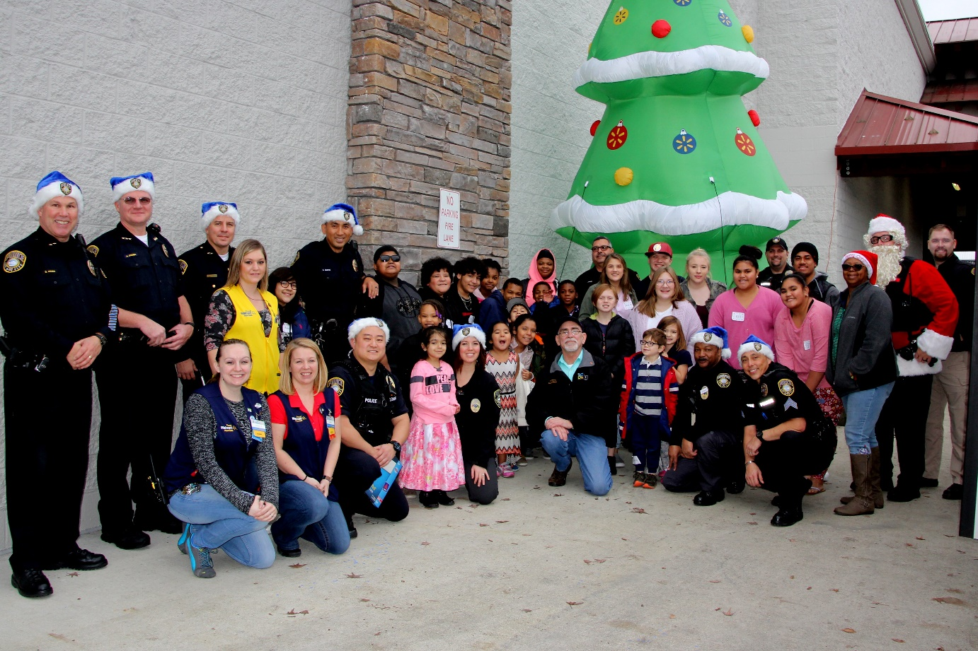

Shop with a Cop
In 2018, Fife PD hosted our first annual Shop with a Cop event!
Partnering with local businesses that donated everything from toys, services, to money that was used towards the program, we were able to kick off our first year raising over $8,000! Families in need were nominated by their fellow community members to spend a special day with a Fife PD Santa Cop.
Given VIP treatment, the children selected joined up with the convoy to Walmart, where upon arrival they were partnered with a Santa Cop to shop for whatever their heart desired! Each family at the end was also given a $150 Walmart gift card to spend as they please. Following the shopping fun, all families, kids, and volunteers headed over to Louie G’s to cap off the day with a pizza party!
Thank you to our corporate sponsor, Lexus of Fife and donors that included Larson Mercedes, BMW Northwest, Northwest Mini, Baydos RV, Systems for Public Safety, Pick-Quick, Sportco, Coca-Cola, many individual donors and the Fife Police Guild.
Your generous donations allowed us to help 30 children!

Slide 16
Grants Awarded
ALPR Automatic License Plate Reader
DRAEGER
LIDAR
$6,000 for purchase of (4) Lidars
$10,000 for purchase of (1) Draeger Alcotest
$20,000 for purchase of (1) ALPR
Denied Firearm Transactions
$14,000 for the investigation of Denied Firearm Transactions

Slide 17
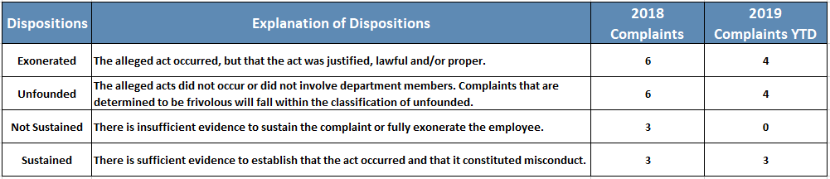
Complaints and IAs
The Fife Police Department takes seriously any allegations of unprofessional behavior or misconduct on the part of our employees and investigates every complaint received.
In 2018, the Department recorded 18 complaints, of which six were exonerated, six were unfounded, three were not-sustained and three were sustained. Fife PD conducted eleven Internal Affairs Investigations in 2018 resulting in a total of ten sustained findings and one exonerated.
Year to date, the Department has recorded 11 complaints, of which four were exonerated, four were unfounded and three were sustained. Fife PD has also conducted one Internal Affairs Investigation in 2019.

Slide 18

Online Reporting
Online Reporting is available for non-emergency reporting of theft, vehicle prowl, vandalism, and lost property incidents that have occurred within the City of Fife.
Online reporting is optional and is offered as a convenience to citizens who are unable to or do not wish to contact an officer directly.
To file an online report, citizens can visit South Sound 911 at https://www2.southsound911.org/onlinereporting/

Slide 19
Major Accomplishments
Moved to Enforcer
Reviewed and Revamped Sex Offender Program and Notification Process
Conducted “Meet the Chief” Events
Implemented Business Block Watch Program
Upgraded and Expanded Functionality of CJC Kiosk

Slide 20
Major Accomplishments
Developed a High Crime Impact Team
Updated Fife PD Webpage and Host
AFIS Fingerprint Scanning
All-Hands Meeting
Asst. Chief Gardner Selected to Attend the FBI National Academy (FBINA) in July 2019

Slide 21
Leadership Team-Building
Supervisors’ Retreat
StrengthsFinder

Slide 22
Upcoming Initiatives
Citizen Advisory Committee
Provide Support for Special Events
Provide Input on Training

Slide 23
Upcoming Initiatives
Non-Commissioned Guild Contract Negotiations
Innovation Award
Scheduling Software
Citizen’s Academy
Tactical Athlete
Team Building
Rewrite Region 5 Mitigation Plan

